Slide 1
Energy Efficiency WSN
LEACH WSN Protocol
Ahmed Mohamed Fawzy………………….89161
Mohamed Emad Abd-Hamid ……………..89094
Mohamed Ahmed Mourad ……………… 89478
Mustafa Mohamed Mustafa…………. .…91548
Mohamed Samir Abd-Alsalam………… 89913
Mohamed Khaled Kamal Ali ………….89590

Slide 2
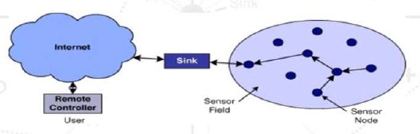
Introduction
A wireless sensor network consists of sensor nodes deployed over a geographical area for monitoring physical phenomena like temperature, humidity so on. Wireless Sensor Network consists of nodes called sensor node and a base station called a sink which are deployed over geographical area.
WSN consists of a sink node, and a large number of sensor nodes; Data collected by the sensor nodes is transferred to the sink

Slide 3
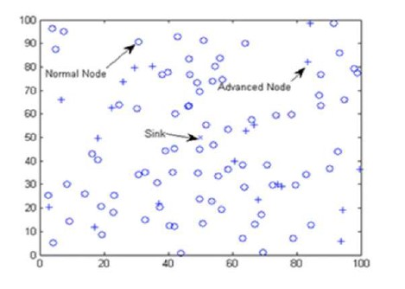
WSN Architecture
A network Model:
Normal Node: sensor
Sink: base station
Advanced Nodes:

Slide 4
Sensor Nodes (Normal Node - Hollow Circle):
These are the basic building blocks of a WSN.
Equipped with sensors to monitor physical parameters (such as temperature, humidity, light, etc.).
Responsible for sensing and collecting data from the environment.
Limited computational and communication capabilities to conserve energy.

Slide 5
Sink Nodes (Base Station - X Sign):
Also known as base stations or sink nodes.
Serve as the central point for data aggregation and communication within the WSN.
Collect data from sensor nodes and transmit it to a central server or processing unit.
Typically have more computational power and energy resources compared to sensor nodes.

Slide 6
Advanced Nodes (+ Sign):
These nodes are sometimes introduced to enhance the capabilities of the WSN.
They may have additional features, such as more powerful processors, larger storage capacity, or improved communication capabilities.
Advanced nodes can act as relays, helping in data transmission or providing additional processing power.

Slide 7
Energy efficiency
The overall architecture of a WSN is designed to efficiently collect and transmit data in a resource-constrained environment. Energy efficiency is a crucial consideration, especially for sensor nodes, as they are often battery-powered and may be deployed in remote or inaccessible locations.
Communication in WSNs is typically wireless and follows protocols optimized for low power consumption, as energy efficiency is a critical factor in the longevity and performance of the network. The collected data is usually transmitted through multi-hop communication to reach the sink node, which then forwards it to a data processing center for analysis.

Slide 8
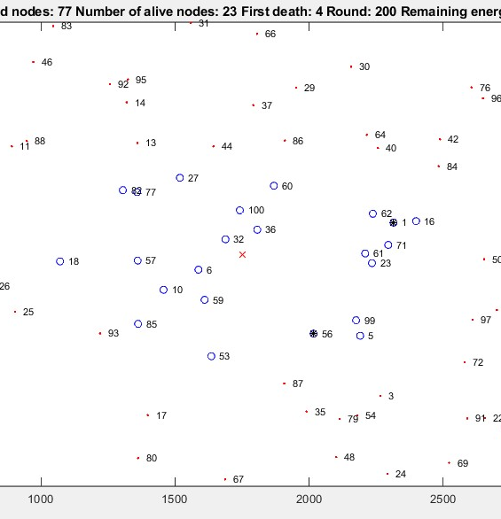
LEACH Protocol Low Energy Adaptive Clustering Hierarchy protocol
LEACH is a hierarchical protocol in which most nodes transmit to cluster heads, and the cluster heads aggregate and compress the data and forward it to the base station(sink). Each node uses a stochastic algorithm at each round to determine whether it will become a cluster head in this round. LEACH assumes that each node has a radio powerful enough to directly reach the base station or the nearest cluster head, but that using this radio at full power all the time would waste energy.
Nodes that have been cluster heads cannot become cluster heads again for P rounds, where P is the desired percentage of cluster heads. Thereafter, each node has a 1/P probability of becoming a cluster head in each round. At the end of each round, each node that is not a cluster head selects the closest cluster head and joins that cluster. The cluster head then creates a schedule for each node in its cluster to transmit its data.
All nodes that are not cluster heads only communicate with the cluster head in a TDMA fashion, according to the schedule created by the cluster head. They do so using the minimum energy needed to reach the cluster head, and only need to keep their radios on during their time slot.

Slide 9
LEACH WSN PROTOCOL Project:
N = 100; % Number of nodes (sensors)
p = 0.1; % Probability of selecting a node as a cluster head
Eo = 70; % Initial energy of nodes
ETX = 1e-11; % Energy consumption for sending a bit by a node and cluster head
ERX = 1e-11; % Energy consumption for receiving a bit by a node and cluster head
Efs = 5e-14; % Energy consumption for amplifying a bit by a node or cluster head for the direct link
Emp = 0.0005e-12; % Energy consumption for amplifying a bit by a node or cluster head for the multi-hop link
EDA = 2e-9; % Energy consumption for aggregation of a bit by cluster heads
m = 0.1; % Percentage of nodes that can become cluster heads in each round
a = 1;
rmax = 200; % Maximum number of rounds
do = sqrt(Efs / Emp); % Threshold distance for direct transmission

Slide 10
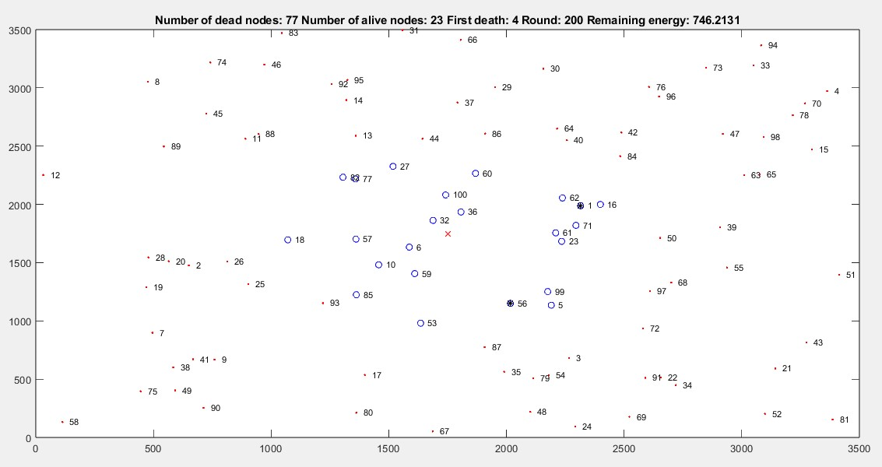
Alive normal node: hollow circle, filled blue circle: cluster head node, Dead node: red dot.

Slide 11
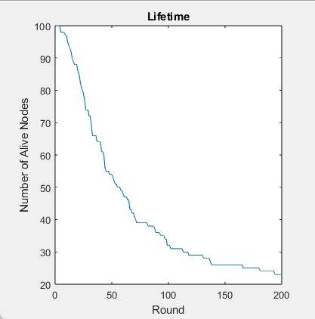
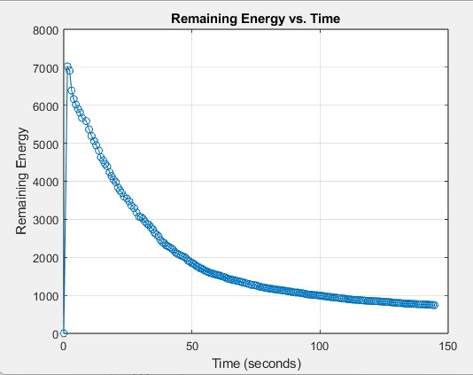
The WSN lifetime (longevity)

